Slide 1

DEPARTMENT OF COMPUTER ENGINEERING
Radiant Games - Online Games Store (SE-A-17)
Students name:
Pranil Belge(11)
Aaryan Chothani(20)
Dipesh Jaiswar(54)
Suyash Kannaujiya(59)
Under the Guidance of: Prof. Vandana Virbhadre

Slide 2
Problem statement
It is not very efficient to buy physical copies of video games as they are not always available and therefore hard to find. There is also a risk of these copies being damaged and thus being useless.
Objectives
To solve the problem of searching for physical copies of video games and making majority of the most popular video games available online at one location.
Radiant Games - Online Games Store

Slide 3
Work Completed
Main (front) page showcasing variety of popular games with filterable genres.
Login and Signup sections.
About page having general information about the project.
Connection to MySQL Database with ‘Login’ & ‘Sign up’ functionality.
Radiant Games - Online Games Store

Slide 4
Work Pending
Browse page allowing logged in users to add games to their wishlists.
Wishlist page showcasing all favorite games of the logged in user.
Radiant Games - Online Games Store

Slide 5
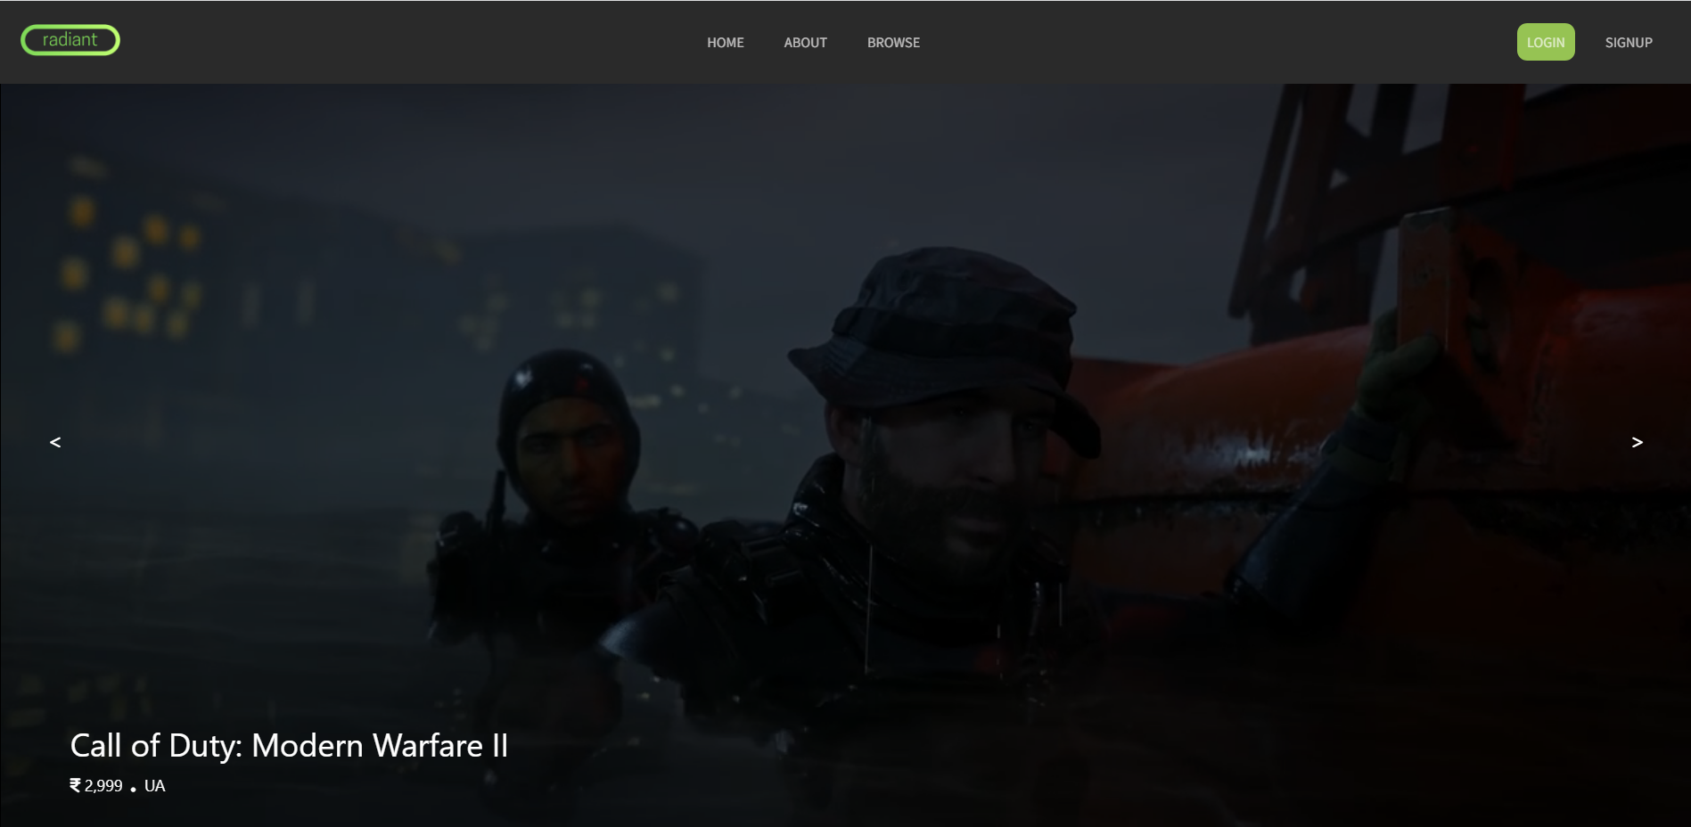
Main page illustration

Slide 6
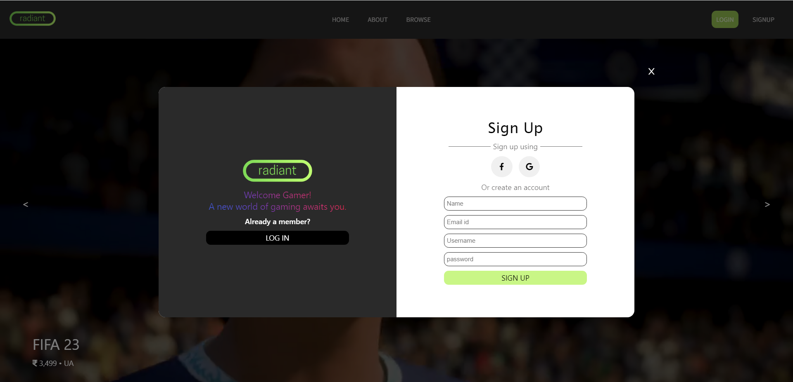
Sign up Section

Slide 7
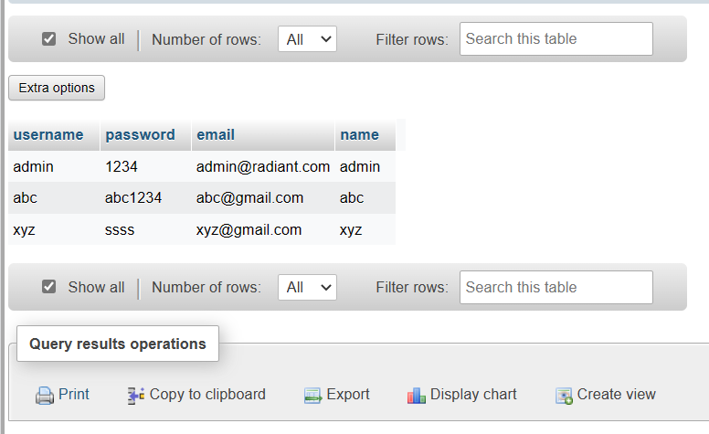
Table in the Database showcasing records inserted through the Login section

Slide 8
Technology Stack
HTML & CSS
JavaScript
PHP
MySQL

Slide 9
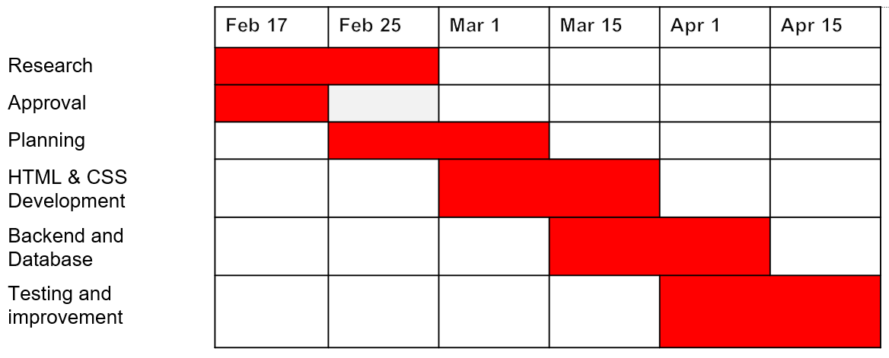
Gantt Chart
Radiant Games - Online Games Store

Slide 10
References
https://store.epicgames.com/en-US/
https://www.gamestheshop.com/
https://www.w3schools.com/
https://www.geeksforgeeks.org/html/
https://www.javatpoint.com/html-tutorial
Radiant Games - Online Games Store

Slide 11
Thank You

